Slide 1
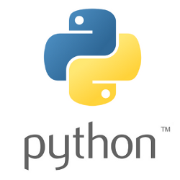
Python

Slide 2
Python (programming language)
Python is an interpreted high-level programming language for general-purpose programming.
Created by Guido van Rossum and first released in 1991.
CPython, the reference implementation of Python
CPython is managed by the non-profit Python Software Foundation (PSF)

Slide 3
Alternative Python Implementations
IronPython (Python running on .NET)
Jython (Python running on the Java Virtual Machine)
PyPy (A fast python implementation with a JIT compiler)
Stackless Python (Branch of CPython supporting microthreads)
MicroPython (Python running on micro controllers)

Slide 4
Version release dates
Python 1.0 - January 1994
Python 1.2 - April 10, 1995
Python 1.3 - October 12, 1995
Python 1.4 - October 25, 1996
Python 1.5 - December 31, 1997
Python 1.6 - September 5, 2000
Python 3.0 - December 3
Python 3.1 - June 27, 2009
Python 3.2 - February 20, 2011
Python 3.3 - September 29, 2012
Python 3.4 - March 17, 2014
Python 3.5 - September 13, 2015
Python 3.6 - December 23, 2016
Python 3.7 – June 27, 2018
Python 3.8 – October 14, 2019
2000
1994
2008
Python 2.0 - October 16
Python 2.1 - April 17, 2001
Python 2.2 - December 21, 2001
Python 2.3 - July 29, 2003
Python 2.4 - November 30, 2004
Python 2.5 - September 19, 2006
Python 2.6 - October 1, 2008
Python 2.7 - July 3, 2010

Slide 5
Python: The Future of Possibilities
Python programming language is one of the fastest growing programming languages present here in this industry.
In fact, python ranked 1st in IEEE spectrum’s list of top programming languages of 2017.
Python has continuously served and is serving as one of the best programming language for
Web development
Application development
System administration
Game development
Security tools development
GIS and much more.

Slide 6
Python: Features
Python programming language is Object-Oriented
Python is a Beginner’s Language
Easy-to-learn
Easy-to-read
Easy-to-maintain
A broad standard library
Portable
Databases
Fewer lines of codes
Notes:
Python programming language is Object-Oriented: Python supports Object- oriented style or technique of programming which encapsulates code within objects.
Python is a Beginner’s Language: Python is a great language for the beginner-level and supports the development of a wide range of applications from simple text processing to WWW browsers to games.
Easy-to-learn: Python has few keywords, simple structure, and a clearly defined syntax which allows the student to pick up the language quickly.
Easy-to-read: Python code is more clearly defined and easy to understand.
Easy-to-maintain: Python’s source code is fairly easy-to maintain its simplicity.
A broad standard library: Python’s bulk of the library is very portable and cross-platform compatible on UNIX, Windows, and Mac(Apple).
Portable: Python can run on a wide variety of hardware platforms and has the same interface on all platforms probably.
Databases: Python provides interfaces to all major database.
Fewer lines of codes: Codes written in python completes in fewer lines thus reducing length of code and making it easier to code faster with more efficiency.

Slide 7
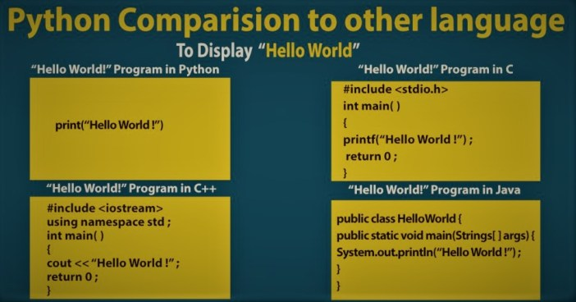

Slide 8
Future technologies relying on python
Artificial intelligence
In the field of AI there is no hiding that python is leading the game.
AI has given way to diverse technologies like speech recognition systems, robots, etc.
Some branches of AI are:
General AI
Text processing
Neural networks
Machine learning
Cognitive science

Slide 9
Future technologies relying on python
Networking
Python is used widely to read write and configure routers.
It has libraries that facilitates writing network based applications.
Many use Python to make sites because there are very good tools available for doing so.
Frameworks like flask and Django make things rather easier.

Slide 10
Future technologies relying on python
Big data and analytics
Due to its simple usage and wide set of data processing libraries, python is the No. 1 contender for big data processing.
Another reason that python is used widely for big data processing is its ability to
Integrate easily with web applications
Generating quick insights
Handling large amount of data sets
Presence of high performance toolkits and libraries.

Slide 11
Websites developed under python
Uber
Instagram
YouTube
Quora
Reddit
Spotify
Flipkart
Pinterest
Slack
Dropbox
NASA etc.

Slide 12
Python as a career
Some of the job profiles associated with python are:
Software engineer
Research analyst
Data analyst
Data scientist
Software developer
Networking

Slide 13

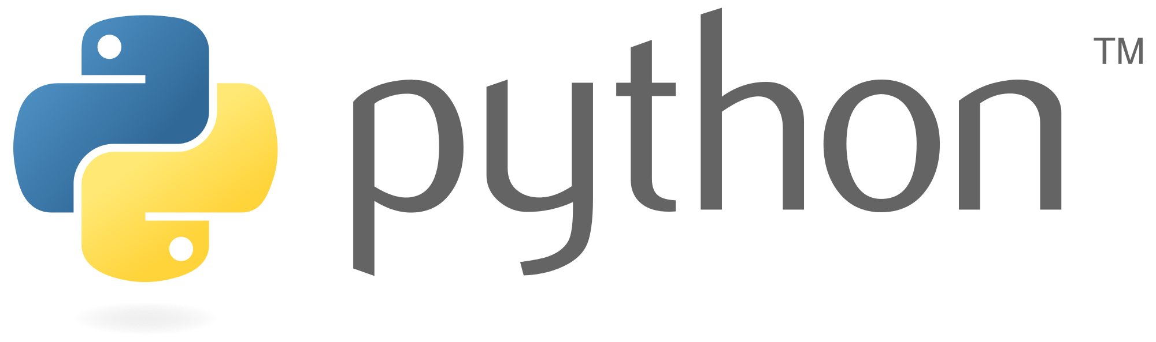

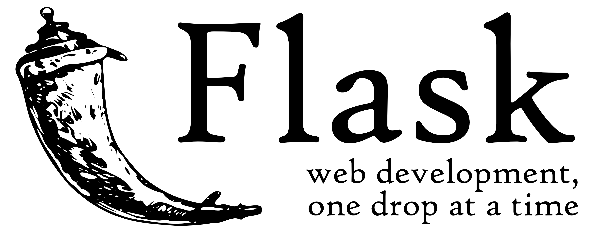
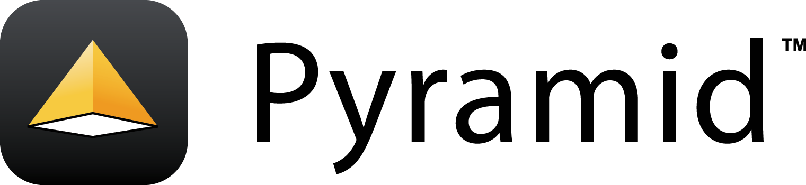
For Web Development

Slide 14

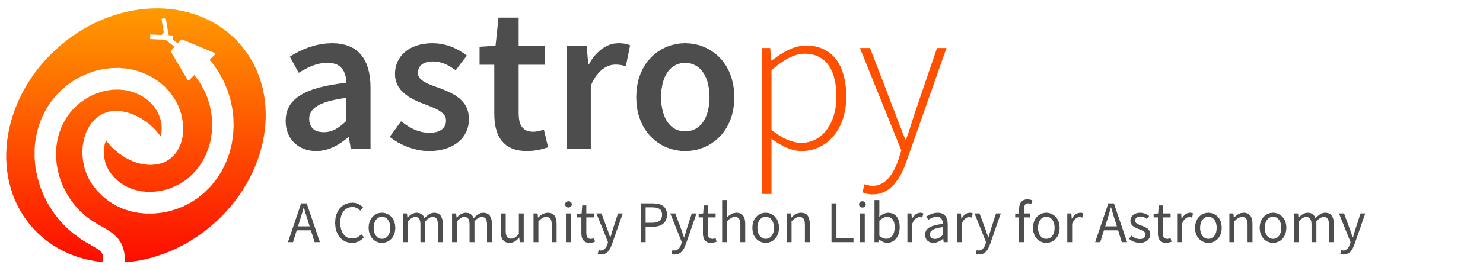
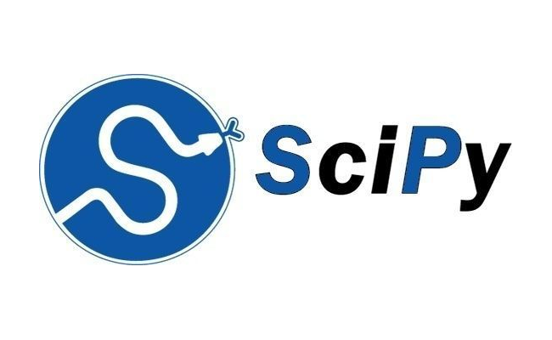

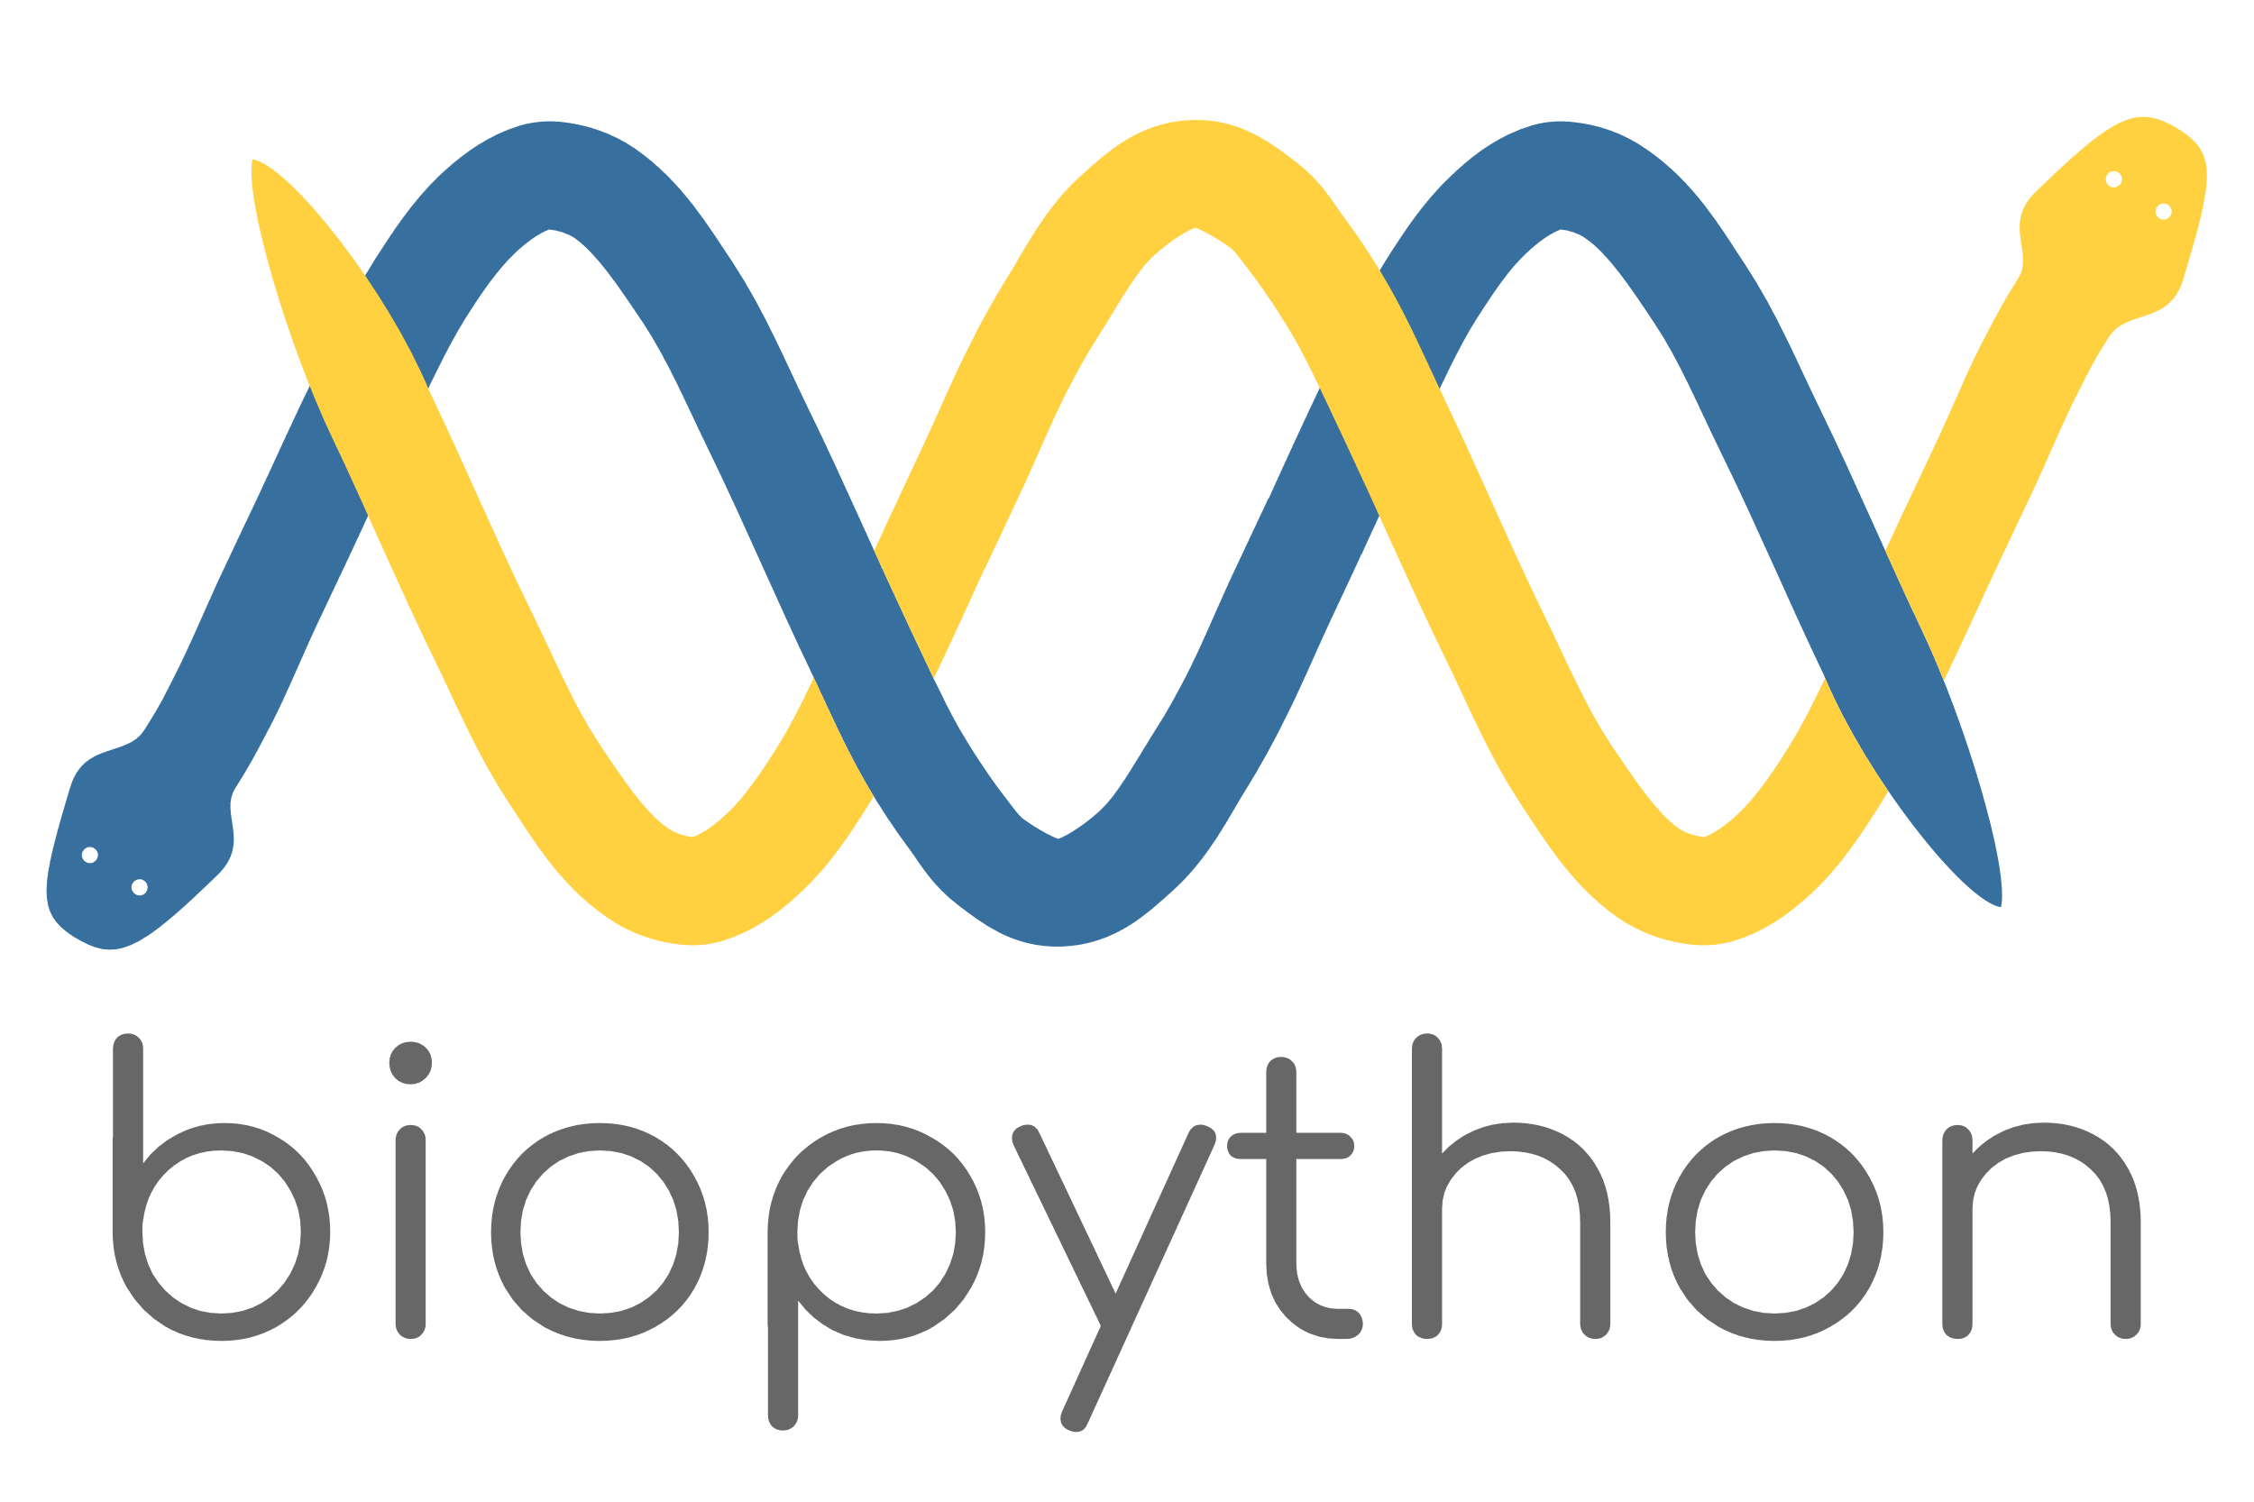
For Science

Slide 15
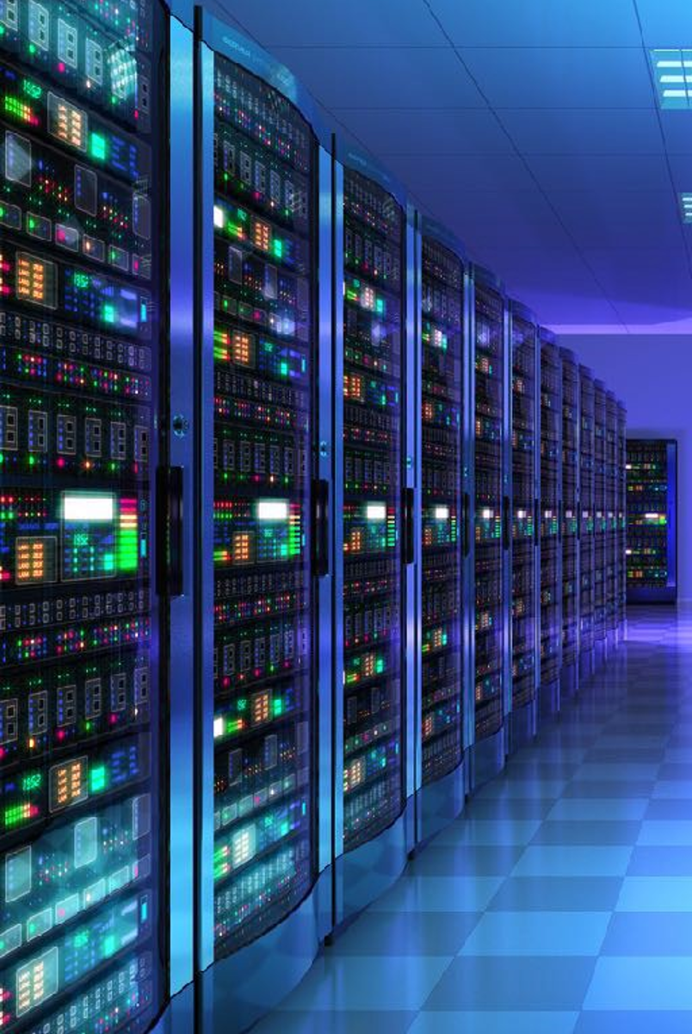
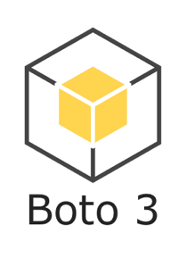
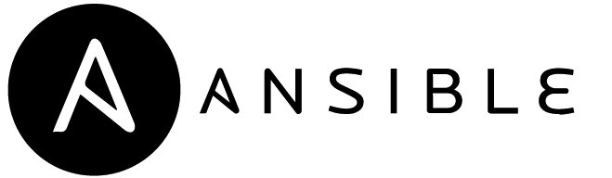

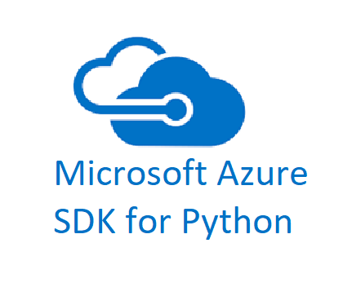
For Cloud Configuration

Slide 16


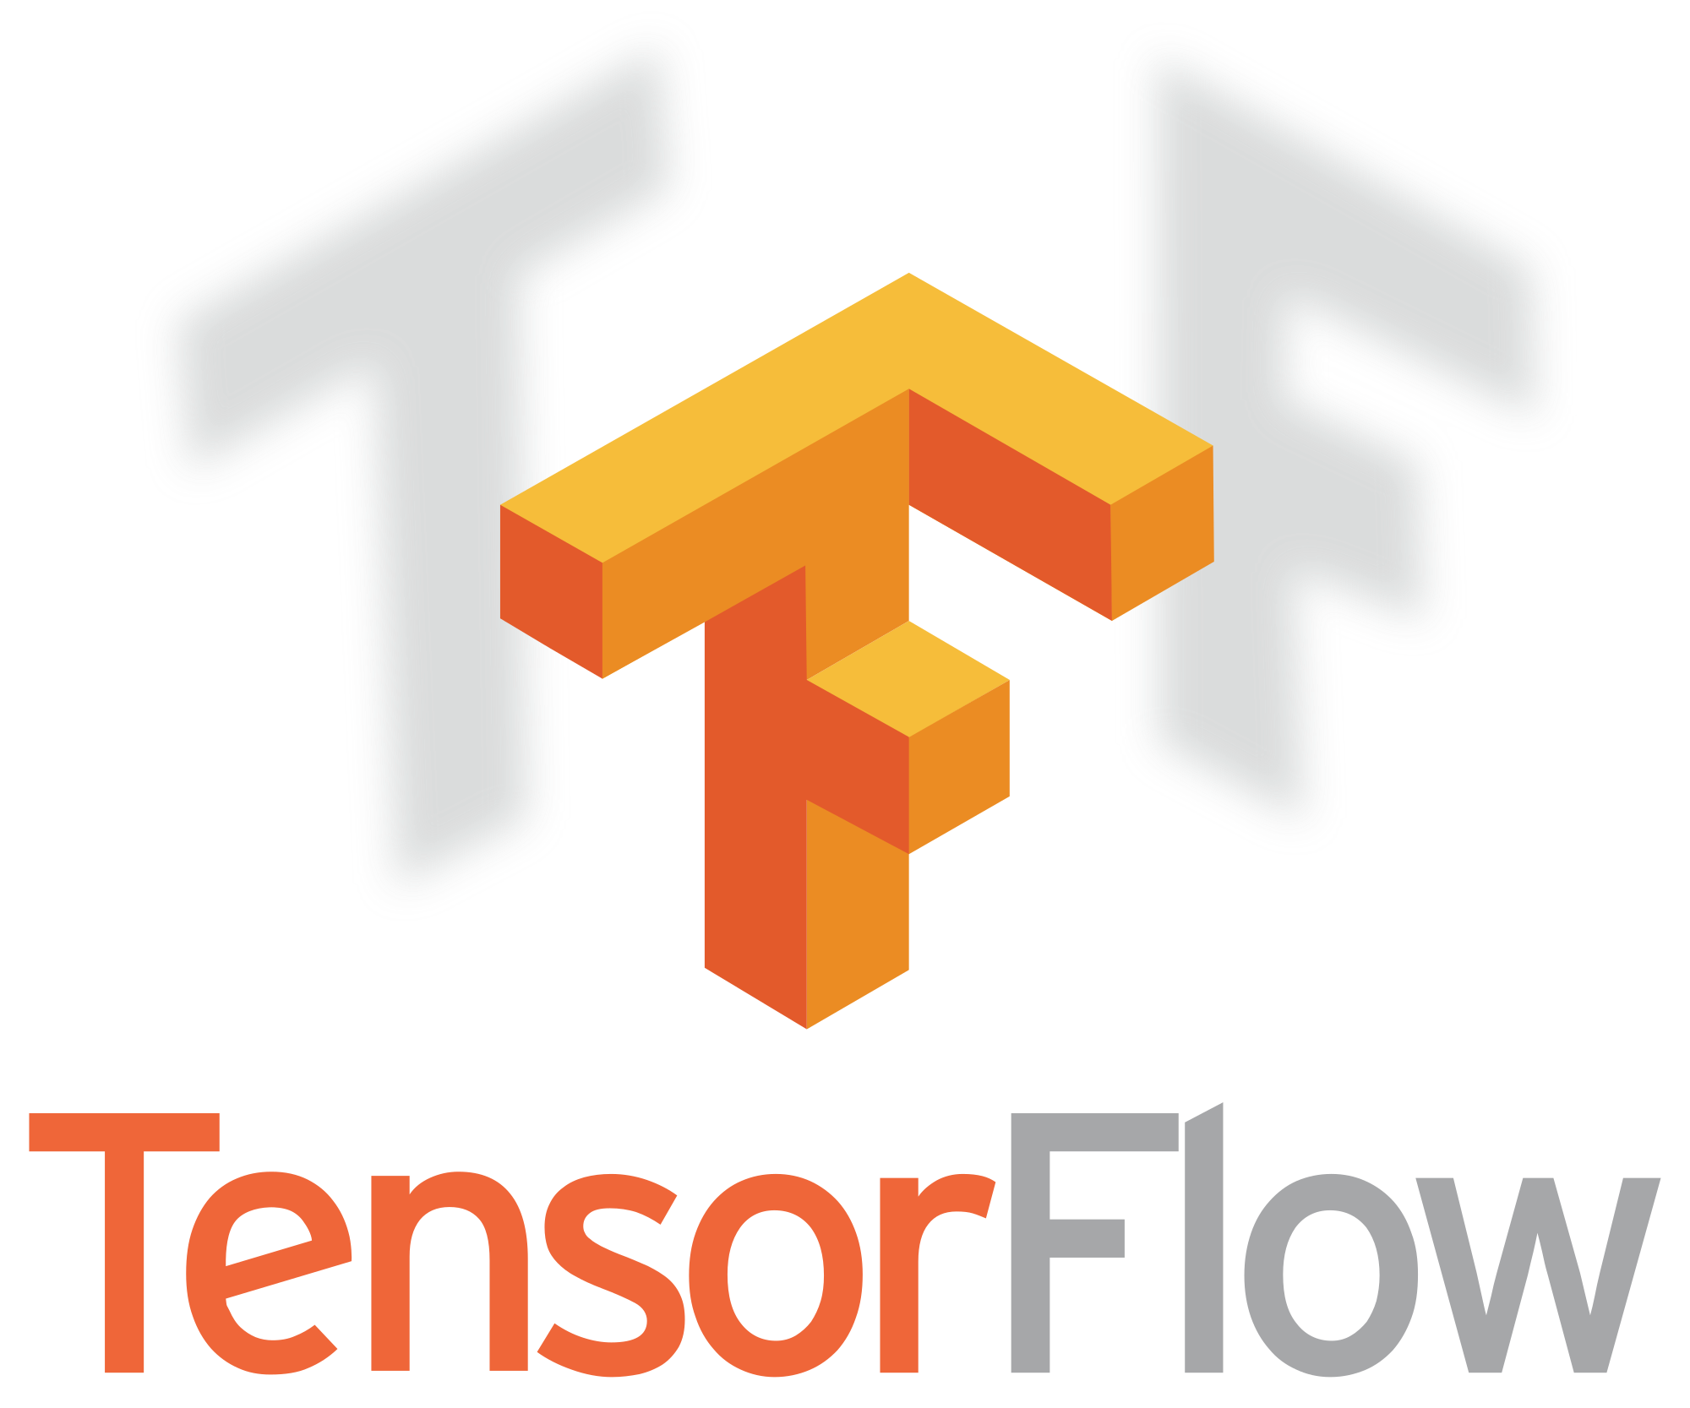
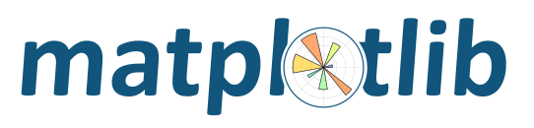

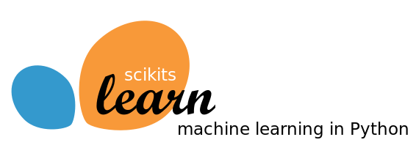
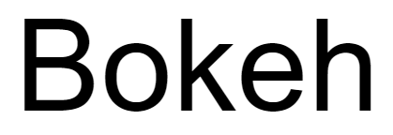
For Data Analytics

Slide 18
comprehensions
REPL
packaging
duck typing
classes
modules
standard library
resources
exceptions
iteration
collections

Slide 19

Batteries Included

Slide 20
Python Standard Library
string
difflib
textwrap
struct
codecs
datetime
heapq
weakref
copy
pprint
numbers
fraction
random
itertools
operator
functools
filecmp
tempfile
glob
linecache
pickle
marshal
configparser
hashlib
logging
time
threading
concurrent
email
asyncio ………

